Slide 1



Leadership Enhancement for Serving Principals (2015-16)
Reflective Report
Ms. Lau Tit Mui
Mr. Fung Chi Tak
Notes:
To view this presentation, first, turn up your volume and second, launch the self-running slide show.

Slide 2
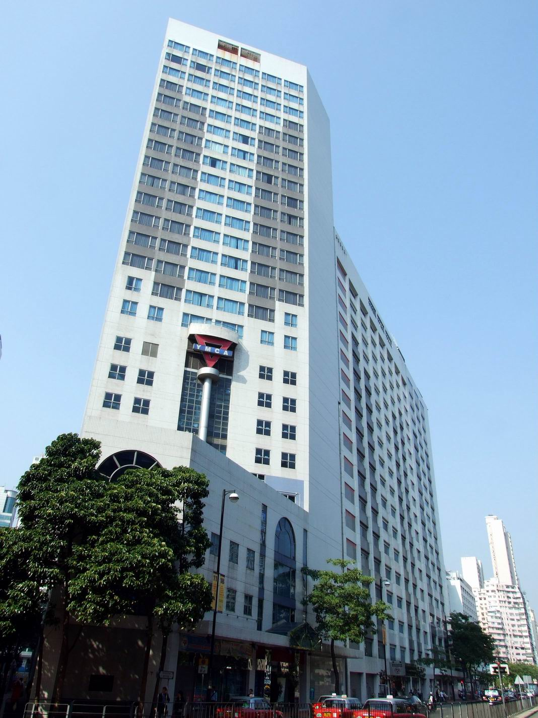
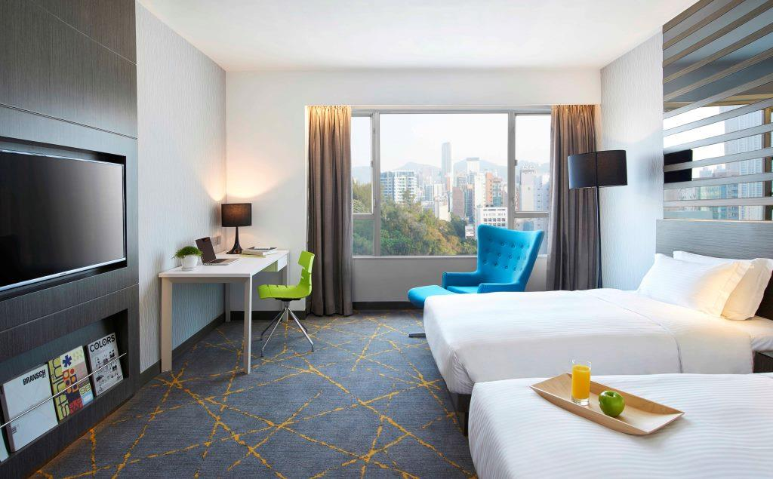

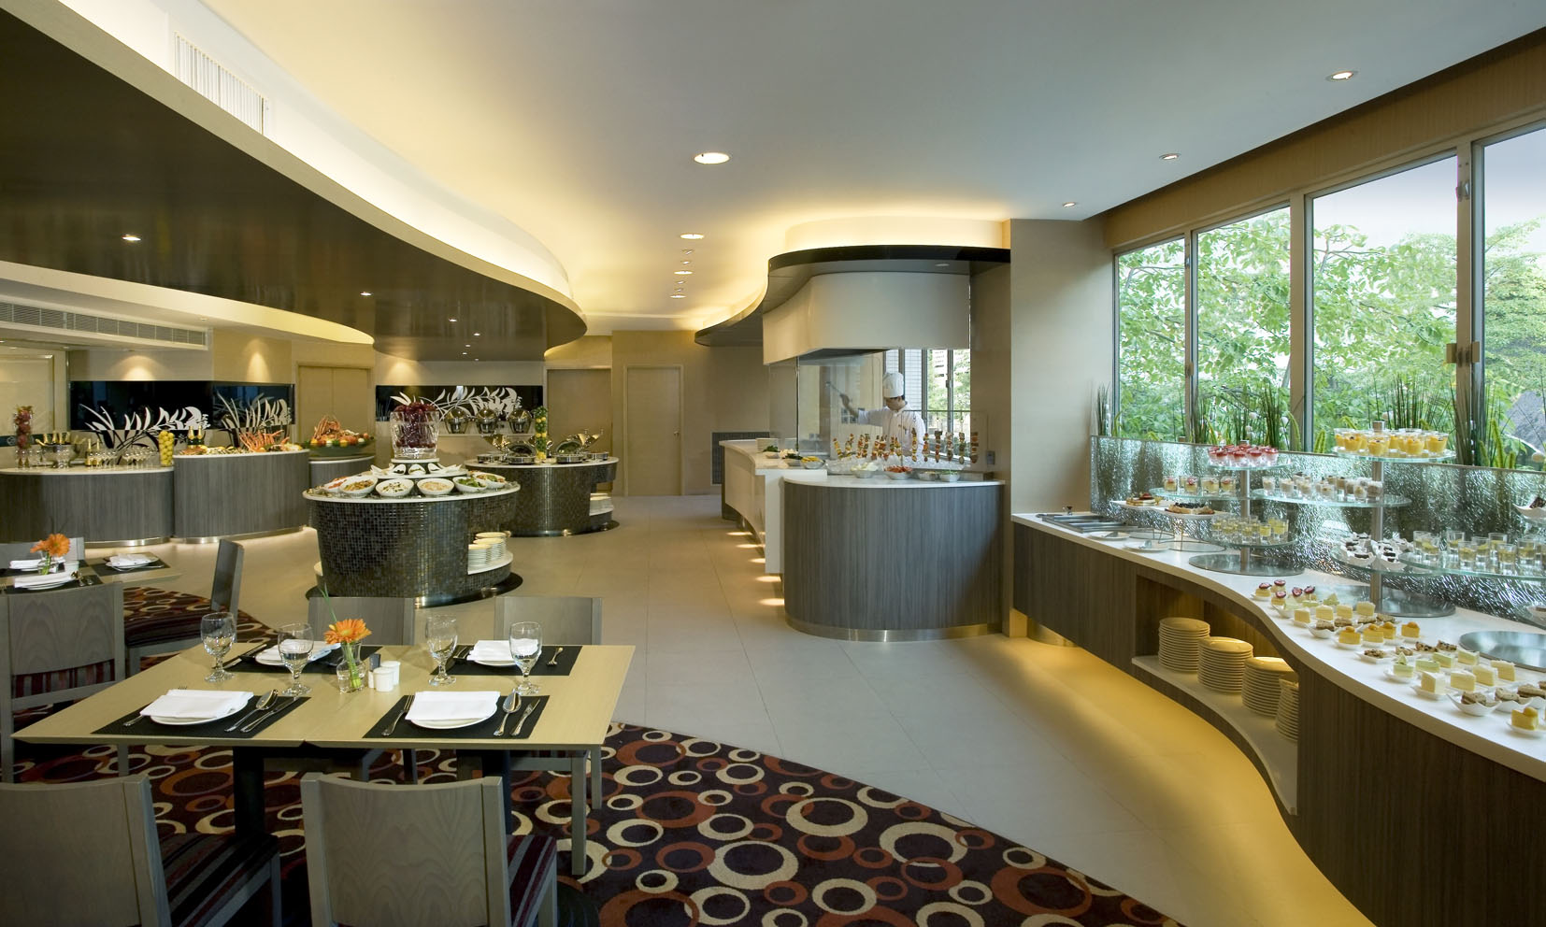

Notes:
To view this presentation, first, turn up your volume and second, launch the self-running slide show.

Slide 3
What we give
Date | Time | Content (Activity/ Conference…)
18/3/2016 | 10:00-11:00 | Preparation meeting
18/3/2016 | 11:00-12:30 | Meeting with GM, Mr Alex Wu
13/4/2016 | 2:00-6:30 | Meeting with Lorraine Wong, Director of Sales
14/4/2016 | 2:00-5:30 | Meeting with Albert Yeung, Food and Beverage Manager
15/4/2016 | 2:00-5:00 | Meeting with 1) Ken Liu, E-Commerce Manager; 2) Gundam Ng, Chief Engineer; 3) Emily Lam, Environmental Officer
20/4/2016 | 5:00-6:00 | Meeting with Dr. Chu
+ 3/3, 19/5, 2/6, ……
Notes:
3

Slide 4

Main findings
From hostel to hotel
From breakeven to surplus
Keeping hotel occupancy rate > 90%
Green hotel
Customer oriented
Notes:
4

Slide 5
What we gain
To see how leadership is applied successfully in an organization
  Organizational Leadership
  Instructional Leadership
  Strategic Leadership
  Community Leadership
Notes:
5

Slide 6
What we gain
Knowledge about running a hotel
  Price setting
  Food and beverage
  Occupancy rate target
  E-commerce
  Green hotel
  Marketing strategy
  ……
Notes:
6

Slide 7
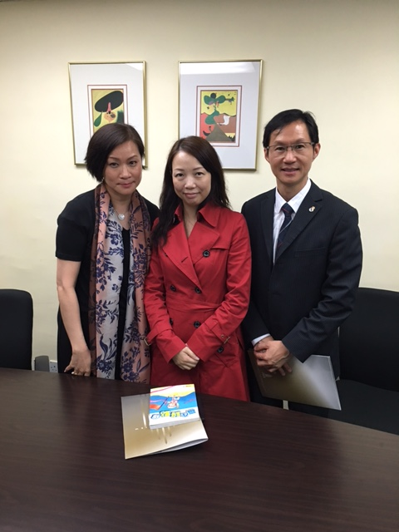
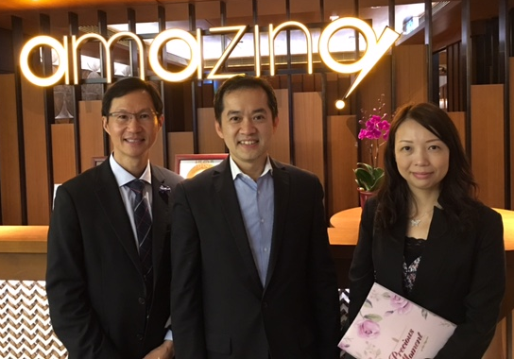
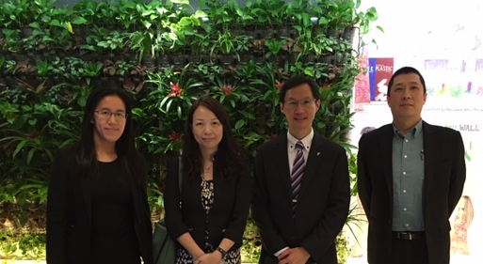
What we gain
Precious Friendship
Notes:
7

Slide 8
What we gain
Attitude, knowledge and skill transferred or to be transferred
  Walking around or in front
  Strong sense of innovation and change
  Full understanding of the environment and big data
  Student-centred policy
Notes:
8

Slide 9
What we gain
Attitude, knowledge and skill transferred or to be transferred
  People oriented
  Leaders communicate with their staff often, and in a variety of ways
Notes:
9

Slide 10
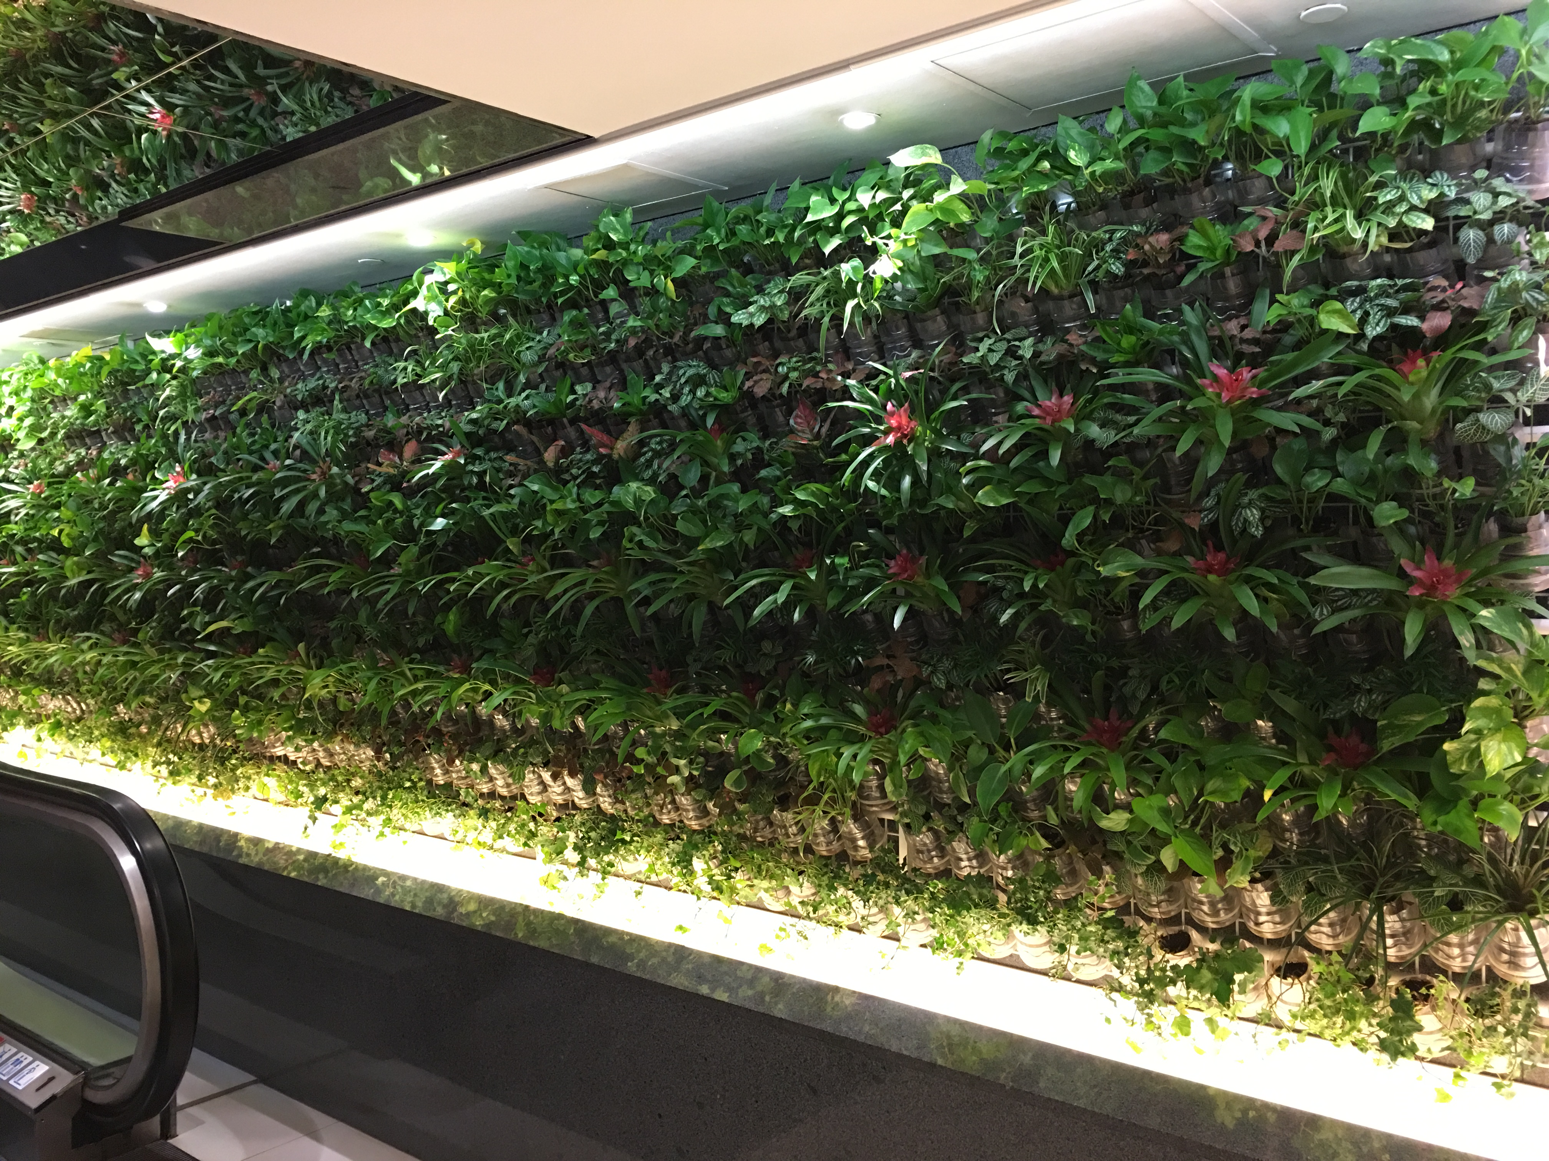

Gain >>> Give

