Slide 1
Programme for Leadership Enhancement for Serving Principals
Company assigned: SUNLIGHT REIT
Learning & Reflection
Prepared by Mr. Kelvin Yau & Mrs. Teri Erh

Slide 3
Organizational Leadership
Organizational Improvement
Setting clear directions
Selling Coffee vs Selling Coffee Experience
Caring for Asset
Staff Development
Nurturing the right people e.g. Enhance Sunlight
Positive reinforcement and corrective feedback
Developing Structures
long-term sustainable strategy/framework

Slide 4
Instructional Leadership
From Coaching to impacting teacher instruction
Setting short term goals
directly and indirectly move the collective behaviors of school staff toward a common goal.
Supportive Management Style
provide coaching, mentoring, assessing, supporting, and reinforcing etc.
Walk an extra mile
Intrinsic and Extrinsic Motivation

Slide 5
Strategic Leadership
Management of Change Proactively
Environmental analysis with high expectations
Careful planning of Entrance Re-construction
Development of manpower:
Enhance Sunlight task force (9 people) from cross departmental staff
Staff Development Fund
Communication:
Closely communication between CEO and the Department Heads
Risk Management:
Collection of risk factors from departments and setting priority
Building Organisation Culture:
Organisation as family

Slide 6
Community Leadership
Corporate social responsibility (CSR):
Environmental (Change of Air-con)
Considering of people (Entrance)
Book Fair (Recycling)
Provide place (Metra City Plaza Shopping Mall)
CEO Hands on himself as demonstration
Encourage Staff to participate

Slide 7
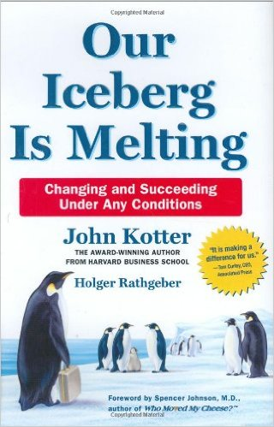
The 8-Step Process of Successful Change
SET THE STAGE 1. Create a Sense of Urgency. 2. Pull Together the Guiding Team. DECIDE WHAT TO DO 3. Develop the Change Vision and Strategy.
MAKE IT HAPPEN 4. Communicate for Understanding and Buy-in. 5. Empower Others to Act.
6. Produce Short-Term Wins. 7. Don’t Let Up. MAKE IT STICK 8. Create a New Culture.

