Slide 1
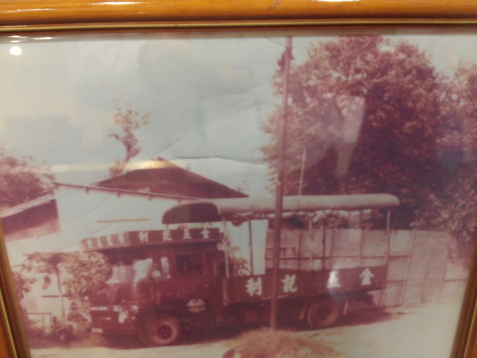
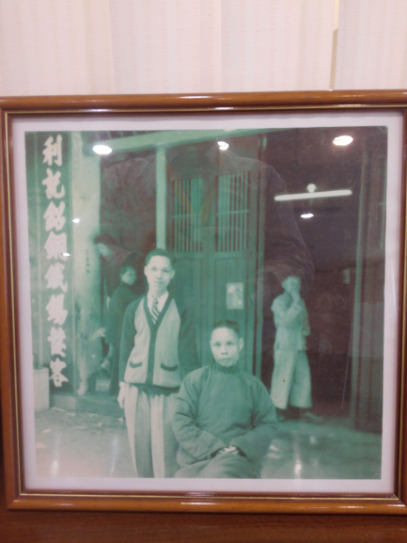
Group T
SC HO
KF CHAN
June 2, 2016

Slide 2
利記於一九四七年於香港成立，由「收買爛銅爛鐵」開始，經過四代經營
現為有色金屬業內具領導地位的國際性綜合供應鏈公司之一，為客戶提供全面的解決方案及增值服務，包括金屬熔煉、全球採購、貨物運輸、倉儲管理及售後服務
在香港股票市場上市 2006
取得 HOKLAS(香 港 實 驗 所 認 可 計 劃 ) 認證 2009
亞洲第一位 LME(倫敦金屬交易所) Cat 5 會員 2015
取得LME (倫敦金屬交易所) LSA(核准採樣及檢測商) 2016

Slide 3
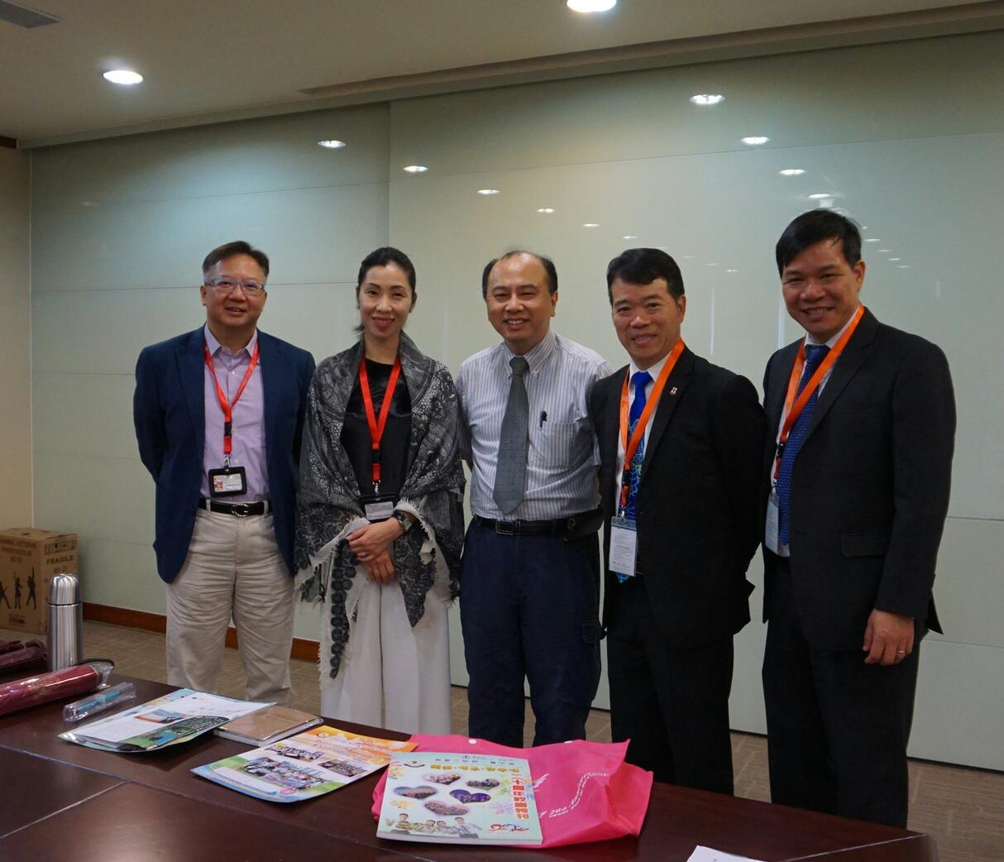
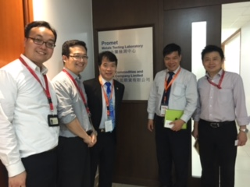
Vice Chairman and CEO
Procurement Director
Chief Financial Officer
Technical Development Manager
General Manager, Production
Marketing Manager
MIS Manager

Slide 4
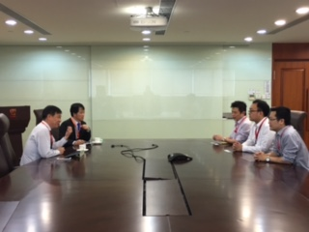
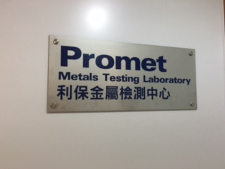
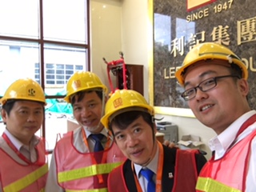
REFLECTIONS ON LEADERSHIP
Always equip a Global perspective
Importance of building and sharing school’s VMV (Vision, Mission and Values)
A Role Model- Integrity and Quality
A BRAND is a PROMISE. Brand name not only out-bound, but in-bound.

Slide 5
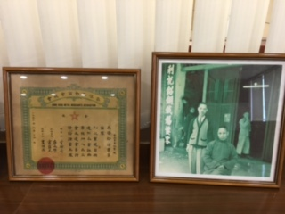
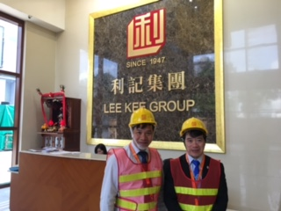
REFLECTIONS ON LEADERSHIP
Tradition and Modern can be kept harmony .
Knowledge management in school/Use communication tools
Encourage teachers to find out the problems and solve them proactively
Family-Friendly Employer. Care for teachers and their families

Slide 6
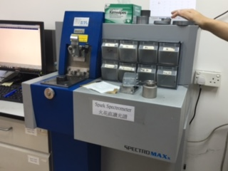
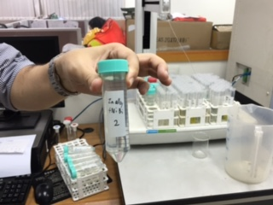
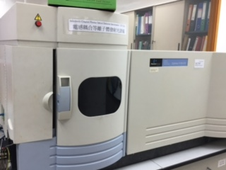

Slide 7
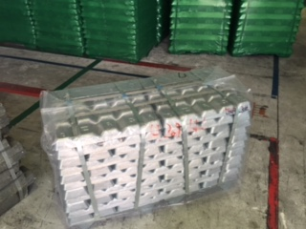
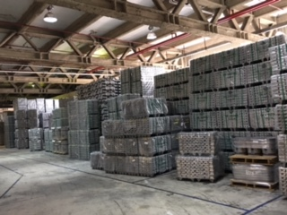
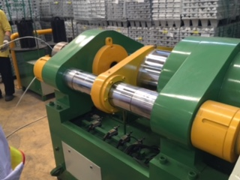
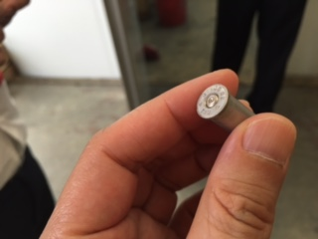

Slide 8
