Slide 1
Leadership Enhancement for Serving Principals
Learning and Reflection
Group 5
Anne Chan , CCC Ming Yin College
Gyver Lau, Chinese YMCA College

Slide 2
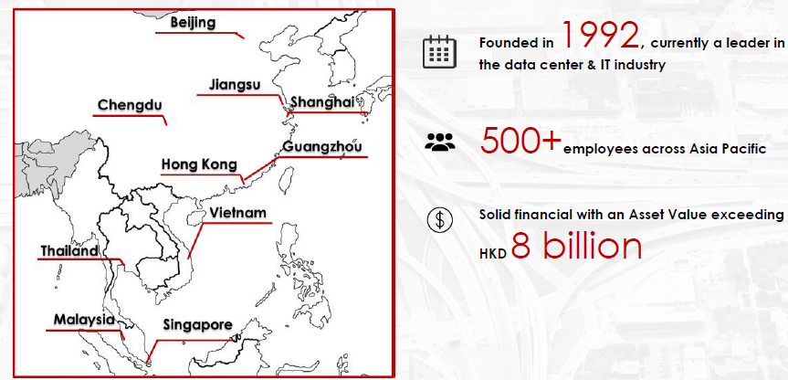
The Legan Group

Slide 3
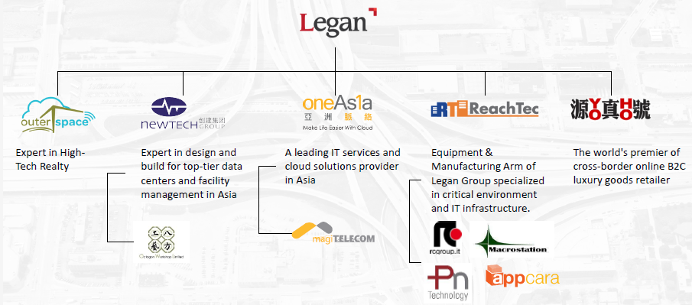
Group Structure

Slide 4
My learning
Organizational Leadership
The structure of Legan
The communication channel among the group leaders
The management style
The Management Trainee Program

Slide 5
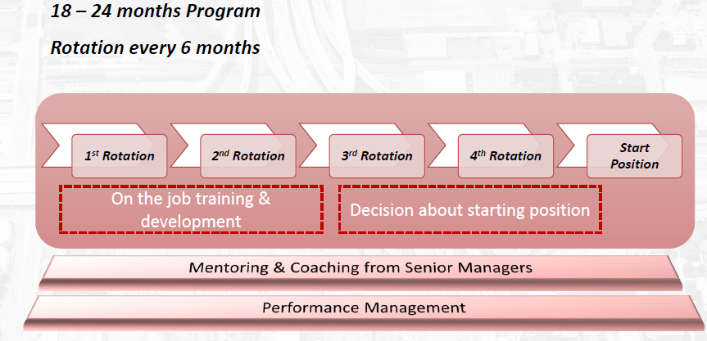
To help Hong Kong build future leaders
Recruit, train, place,
Professional
Leader

Slide 6
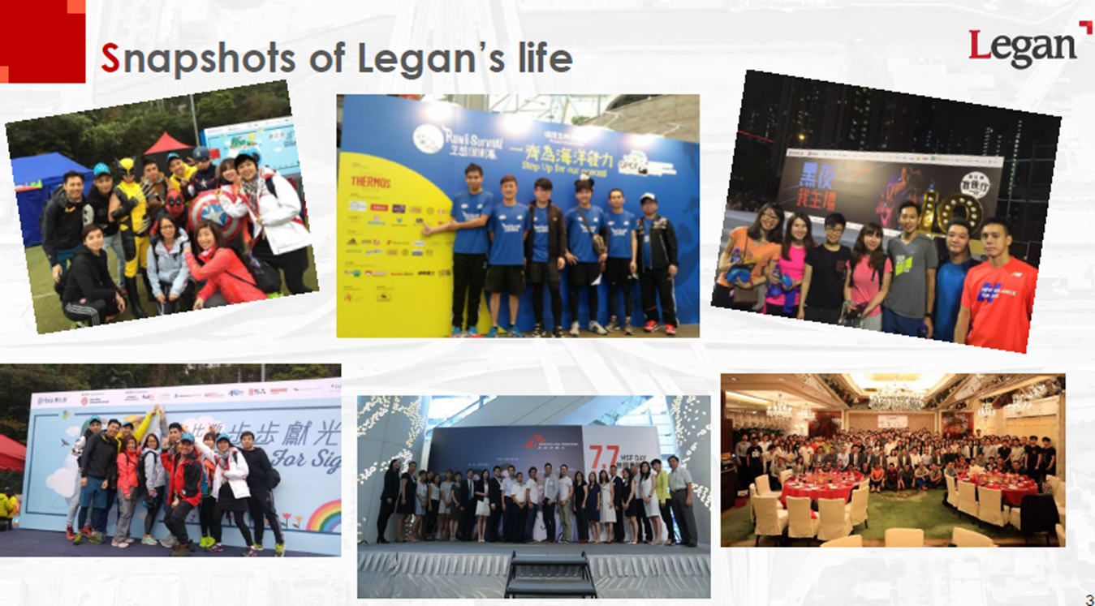
My learning
Strategic leadership
Building Organizational Culture

Slide 7
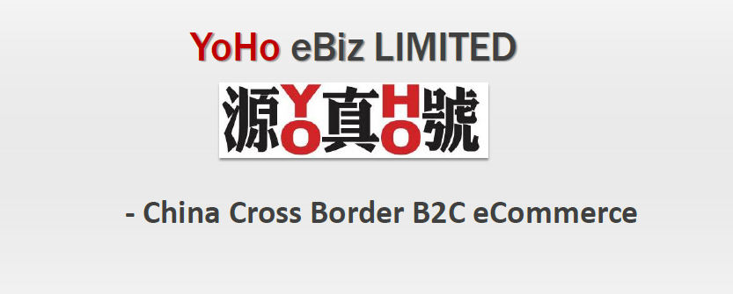
My learning
Strategic leadership
Managing Change

Slide 8
Attitude
Attitude is the key to define a future leader
In the Legan program where different Department Directors shared their leadership experience, the attitude of being open-minded, the quest to learn, the will to change and to improve are mentioned as pre-requisites of a leader.
My reflection is that secondary schools are important in training young people in seeing the world with a right attitude. How attitude can be build up? Is it the core issue of most subjects’ training? It is often said that ‘attitude’ ‘knowledge’ and ‘skills’ are of equal importance in the delivery of the school curriculum. However, in the daily operation of most schools, knowledge and skills are still taking up most of the timetable’s share. Is role modeling the key to teaching students’ ‘attitude’?

Slide 9
Knowledge
Differences in management of business and schools as organizations
How Legan set goals to achieve the sales is different from how schools set goals to improve the students’ performance.
The team building technique in a business organization is basically different in nature from the education sector.
The ways to deal with underperform staff is also different in a business corporation.
The incentive for work also varied.

Slide 10
Skills
Leadership skills
The ability of the leader(s) to lead, to train and to work collaboratively to create a vision and to meet the need of the market.
Communication skills are essential in all tiers of work performance. The management trainee program offered by Legan showed how the company picked the right person to train and how the company mentored the right person to continue to learn.
Cross disciplinary skills are required in all kinds of problem solving in business operation.
Most schools are still facing the problem of making holistic approach in school change. Most subjects are still segregated in their own knowledge domain and they find it hard to collaborate in helping students to understand the changing world in a holistic manner.
Giving incentive, giving direction, monitoring the execution of jobs are required.

Slide 11
Keep
I will keep moving on to help the school change its organization structure to meet the changing requirement of the new curriculum needs as what I learnt from Legan is that the leader should keep changing with the demand of the market. Though initiating change will cause resistance, and sometimes change will slower the performance of the organization, a change in the right direction will help the organization to continue to grow. It is a necessary movement to help the organization to sustain its growth.
I will keep my style of communication and to let ALL staff have a channel to share what they want, what they need and what they think about the ‘change’ I initiated in school. I will listen to them and will try to share their worries. As what I learnt from Legan, good leaders are good ‘role models’. In a school, the school leader should always be able to demonstrate ‘instructional leadership’ and to show frontline teachers how to solve problems in a school context, from teaching, classroom management, dealing with parents and working with the external school partners. It is important to build a community with good trust.

Slide 12
Change
I will try to change the pace of the reform I try to take. Learning from the Legan example, the strategic plan on an organization’s development have to be built on it established culture. In order to maintain a sustainable growth, it is important to expand its business (moving from the core to the fringe; and from the established to the new). However, it is more important to stand back and plan before taking the move. Before any huge reform is to be carried out, consensus among the significant team players should be reached. It is until trust is built and respect is earned, then reform can be carried out smoothly. Getting the right pace in change implementation is more important to meet the setting schedule for the change to be carried out.
I may try to learn to be more careful and pay more attention to the precision requirement. Learning from the building of the data centre where precision and contingency calculation is of paramount importance, I shall ask myself to put more time and effort in making sure that the outcome of the completed task is of excellent quality. The more time and effort spent, the more gain. Passion and dedication is a must to make things work.

Slide 13
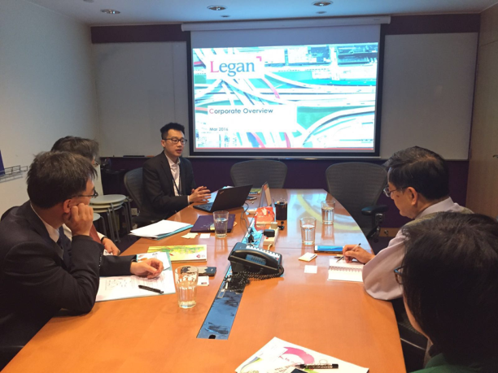
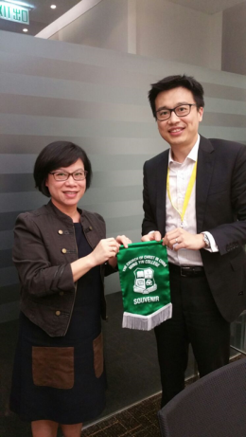
Reflection
Synergy
Proactive
Role modelling
Stop and Think
Organizational restructure
A learning organization

Slide 14
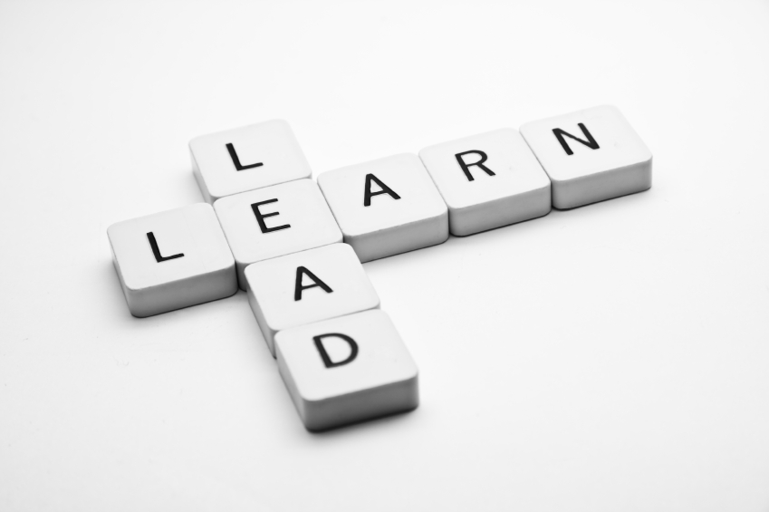
Instructional Leadership
Organizational Review
  Specialization
  Lines of command

Slide 15
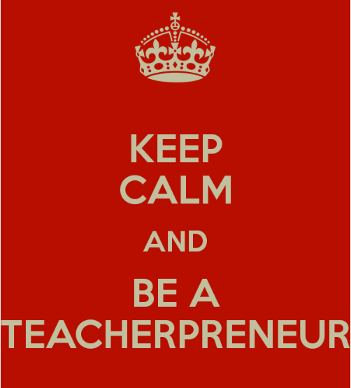
Instructional Leadership
Teacherpreneurs
  Uplifting young teachers
  Enhancing experienced teachers
  Nurturing middle managers
  Empowering future leaders

Slide 16

Instructional Leadership
Knowledge Management
  Create knowledge platform for sharing
  Disseminate school information and good practices

Slide 17
Community Leadership
Lead the school to outreach to the community
  Encourage teachers to join education community at large
  Establish long term partnership with few NGO elderly centres

Slide 18

Community Leadership
Serving globally
  Collaborate with overseas NGO through YMCA network
  Identify global voluntary services opportunities

Slide 19
Community Leadership
Lead the school to share with teachers community at large
  Local seminars
  Territory symposiums
  International Conference

