Slide 1
Hong Kong Baptist University
Programme for Leadership Enhancement for Serving Principals 2016
Group A1-2:
Dr Chu Kai wing alex (instructor)
Mr. Chan chi chiu Daniel
Ms. Wong pui yi emily

Slide 2




Slide 3

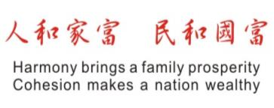

Slide 4
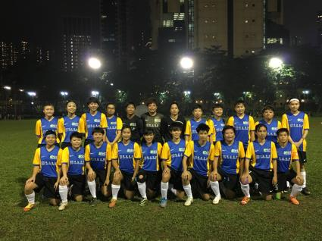

Wofoo Football Team
“We Care HK” Activity

Slide 5
What we did……

Slide 6
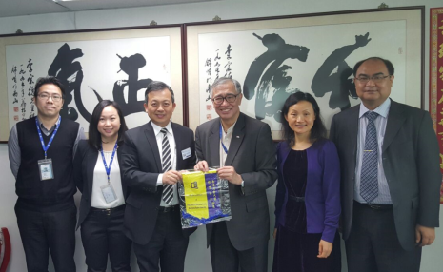
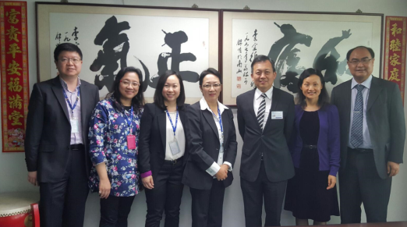
6 April 2016
Meeting with the Senior Management

Slide 7
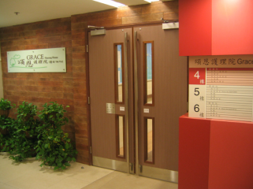
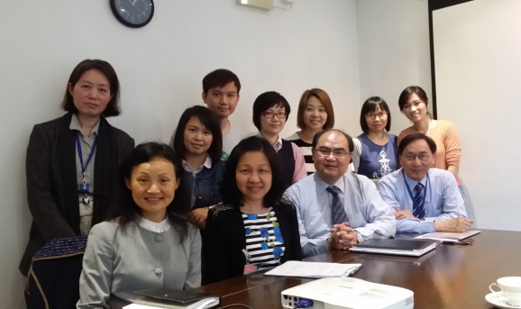
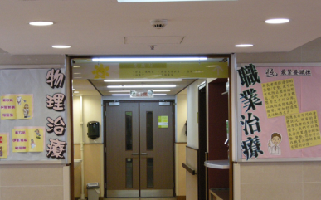
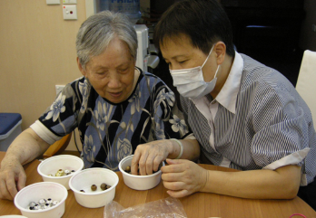
14 April 2016
Visit to Grace Nursing Home

Slide 8
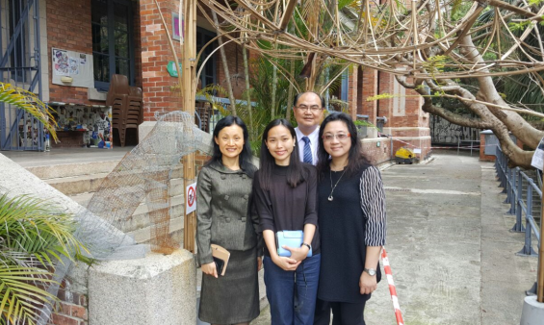
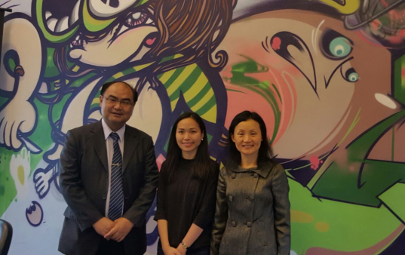
20 April 2016
Visit to Warehouse Youth Centre

Slide 9
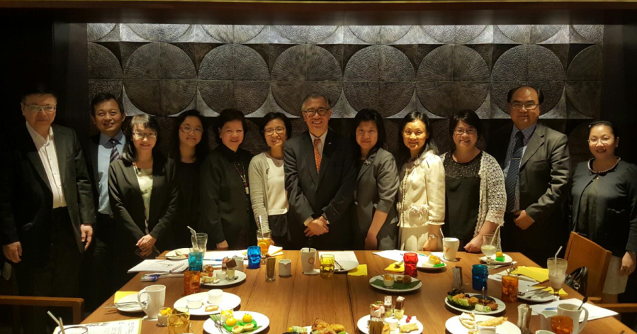
29 April 2016
Sharing at Tea Gathering

Slide 10
Our most important takeaways

Slide 11
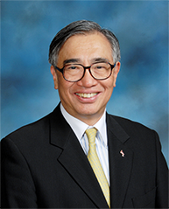
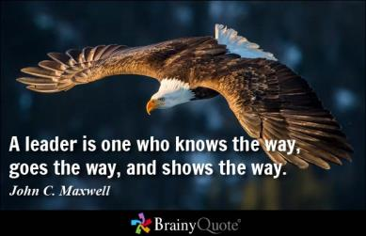
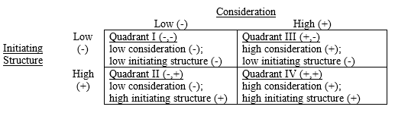
1. A great leader:
Has moral appeal
Has vision & mission
Is goal-oriented
Is hardworking
Has good rapport with staff
Dr Joseph Lee, GBS, OStJ, JP
Chairman
李宗德太平紳士
主席

Slide 12
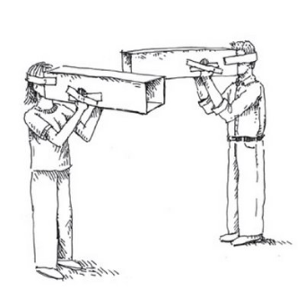


2. Build a strong middle management that:
Promulgates the organizational culture
Thinks out of the box
Steps out of the comfort zone
Sees the value of networking
Presents and shares to others

Slide 13
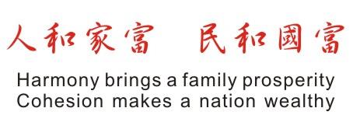
3. A clear direction
– The importance of a motto

Slide 14
校和人樂
Vision binds a school closely

Slide 15
人和校進
Cohesion makes great schools

